Slide 1
Chapter 4
Empirical Investigation
Prepared by: Mintesinot A.

Slide 2
SE Investigation
What is software engineering investigation?
Applying “scientific” principles and techniques to investigate properties of software and software related tools and techniques.
Why talking about software engineering investigation?
Because the standard of empirical software engineering research is quite poor.
“the scientific method is merely a formalization of learning by experience”

Slide 3
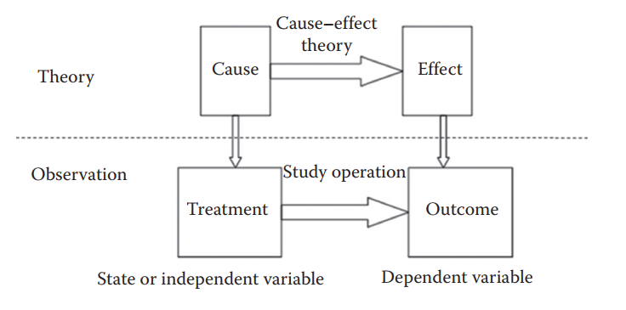
SE Investigation(cont.)
An empirical study examines some specific sample or observation of all of the possible values of the variables involved in a cause–eﬀect relationship.
Empirical theory

Slide 4
SE Investigation: Examples
Experiment to confirm rules-of-thumb
  Should the LOC in a module be less than 200?
Experiment to explore relationships
  How does the project team experience with the application affect the quality of the code?
  How does the requirements quality affect the productivity of the designer?
  How does the design structure affect maintainability of the code?
Experiment to initiate novel practices
  Would it be better to start OO design with UML?
  Would the use of SRE improve software quality?

Slide 5
SE Investigation: Why?
To improve (process and/or product)
To evaluate (process and/or product)
To prove a theory or hypothesis
To disprove a theory or hypothesis
To understand (a scenario, a situation)
To compare (entities, properties, etc.)
For better processes, tools, and languages to gather and analyze requirements, model designs, develop, test, and evolve applications.

Slide 6
SE Investigation: What?
developers performance
Tool’s performance
Person’s perceptions
Tool’s usability
Document’s understandability
Program’s complexity etc.

Slide 7
SE Investigation: How?
Hypothesis/question generation
Data collection
Data evaluation
Data interpretation
Feed back into iterative process

Slide 8
SE Investigation Principles
There are key principles of investigation:
Selecting investigation technique: conducting surveys, case studies, formal experiments
Stating Goal & hypothesis: What should be investigated?
Maintaining control over variables: dependent and independent variables
Treats to validity: No study is perfect; there are many ways that a study can provide misleading results.
Human subjects: government and university regulations require that research involving human subjects meet specified standards.

Slide 9




1. Selecting investigation technique
Three ways to investigate:
  Formal experiment: A controlled investigation of an activity, by identifying, manipulating and documenting key factors of that activity.
  Case study: Document an activity by identifying key factors (inputs, constraints and resources) that may affect the outcomes of that activity.
  Survey: A retrospective study of a situation to try to document relationships and outcomes.

Slide 10
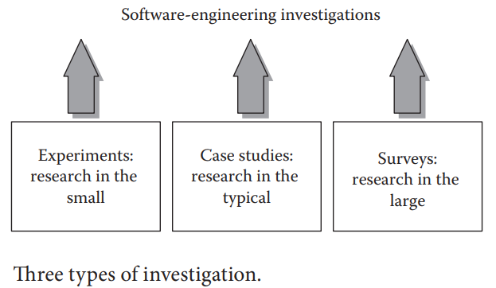
Selecting investigation technique(cont.)

Slide 11
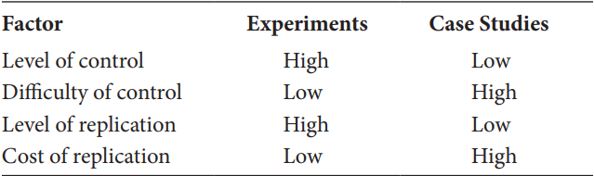
Selecting investigation technique(cont.)
Factors Relating to Choice of Research Technique

Slide 12
Guidelines to choose A particular investigation method
If the activity has already occurred, we can perform survey or case study. If it is yet to occur, then case study or formal experiment may be chosen.
If we have a high level of control over the variables that can affect the outcome, then we can use an experiment.
If we have no control over the variable, then case study will be a preferred technique.
If replication is not possible at higher levels, then experiment is not possible.
If the cost of replication is low, then we can consider experiment.

Slide 13
2. Stating Goal & hypothesis:
The first step is deciding what to investigate.
The goal for the research can be expressed as a hypothesis in quantifiable terms that is to be tested.
The test result (the collected data) will confirm or refute the hypothesis.
The goal for your research can be expressed as a hypothesis that you want to test.
The hypothesis is the tentative idea that you think explains the behavior you want to explore.

Slide 14
Stating Goal & hypothesis(cont.)
Examples:
  Eg1. Can integrated development and testing tools improve our productivity?
  Eg2. Does Cleanroom software development produce better-quality software than using the conventional development methods?
  Eg3. Does code produced using Agile software development have a lower number of defects per KLOC than code produced using the conventional methods?
  Eg4.“Using Scrum produces better quality software than using the Extreme Programming method.”

Slide 15
Stating Goal & hypothesis(cont.)
The method used is to first evaluate a null hypothesis, which states that the proposed relationship does not hold.
  The null hypothesis relevant to Example 4
  Hyp0: “There is no diﬀerence between the quality of software produced by the Scrum method and the quality of the software produced by using the XP method as indicated by defects per thousand lines of code”.
Reject the null hypothesis only if there is less than a 5% chance that there is no diﬀerence between the two groups.

Slide 16
Stating Goal & hypothesis(cont.)
Only after your analysis shows conclusively that you can reject the null hypothesis, you can evaluate alternative hypotheses:
  HypA1: “The code produced using Scrum will have fewer defects per thousand lines of code than the code produced using the XP method.”
  HypA2: “The code produced using XP will have fewer defects per thousand lines of code than the code produced using the Scrum method.”

Slide 17

3. Maintaining Control over Variables
What variables may affect truth of a hypothesis? How do they affect it?
Variable:
  Independent/ State variables(values are set by the experiment or initial conditions)
  Dependent (values are affected by change of other variables)
Example: Effect of “programming language” on the “quality” of resulting code.
  Programming language is an independent and quality is a dependent variable.

Slide 18
3. Maintaining Control over Variables(cont.)
A state variable is used to distinguish the control situation from the treatment in a controlled experiment.
When you cannot diﬀerentiate control from treatment, you must do a case study instead of a controlled experiment.

Slide 19
4. Threats to Validity
There are many ways that a study can provide misleading results.
Potential problems with empirical studies are classified as categories of threats to validity.
There are four categories of threats to validity:
Conclusion validity- Using the wrong statistical tests, having too small a sample, Searching for relationships between too many variables
Construct validity- use meaningful measures that have
been validated in the narrow sense

Slide 20
4. Threats to Validity(cont.)
Internal validity- Internal validity refers to the cause–eﬀect relationship between independent and dependent variables.
  A study has internal validity if the treatment actually caused the eﬀect shown in the dependent variables.
  Specific threats include the eﬀects of other, possibly unidentified, variables.
External validity- External validity refers to how well you can generalize from the results of one study to the wider world.
  The ability to generalize depends on how similar the study environment is to the environment used in actual practice.

Slide 21
5. Human Subjects
Human subject means a living individual about whom an investigator (whether professional or student) conducting research obtains
Data through intervention or interaction with the individual
Identifiable private information
Software engineering studies rarely involve risks of physical harm to human subjects.
  The major risks are due to privacy issues.

Slide 22
Planning Experiments
A Process Model for Performing Experiments: six-phase process
Conception
Defining the goal of experiment
To ensure that a controlled experiment, case study, and/or survey are appropriate.
Design
Generating quantifiable (and manageable) hypotheses to be tested
Defining experimental objects or units
To plan how the application of these conditions test your hypothesis and answer your objective question

Slide 23
Planning Experiments(cont.)
Preparation
  Getting ready to start, e.g., purchasing tools, configuring hardware, training personnel, etc.
  Instructions must be written out or recorded properly.
Execution
  Conduct the experiment
  Following the steps laid out in the plan
  Measuring attributes as prescribed by the plan, you apply the treatment to the experimental objects.

Slide 24
Planning Experiments(cont.)
Analysis
  The analysis phase has two parts
    Review all the measurements taken to make sure that they are valid and useful.
    Analyze the sets of data according to the statistical principles
Dissemination & decision making
  Documenting conclusions to duplicate experiments & confirm conclusions in a similar setting.
  To support decisions how to develop or maintain software in the future

Slide 25
Key Experimental Design Concepts
Simple designs - make the experiment practical, minimize time, money, personnel, easier to analyze & experimental resources.
The three key experimental design concepts: Replication, Randomization, & Local control.
Replication:
Involves repeating an experiment under identical conditions, rather than repeating measurements on the same experimental
unit.
  To know how much confidence we can place in the results of the experiment.
  Replication enables us to estimate the mean eﬀect of any experimental factor.

Slide 26
Key Experimental Design Concepts(cont.)
Randomization:
  The random assignment of subjects to groups or of treatments to experimental units, so that we can assume independence (conclusion & internal validity) of results.
Local control:
  Local control refers to the control that you have over the placement of subjects in experimental units and the organization of those units.
    Blocking means allocating experimental units to groups so that the units within a block are relatively homogeneous.
    Balancing is assignment of treatments – an equal number of subjects is assigned to each treatment.

Slide 27
Types of Experimental Designs
An independent variable is called a factor in the experimental design
Various values or classifications for each factor are called the levels of the factor. Levels can be continuous or discrete, quantitative or qualitative.
Eg. A study to determine the effect of experience and language on the productivity of programmers has two factors: experience and language. The dependent variable is productivity.
Most designs in software engineering research are based on two simple relations between factors: Crossing and Nesting

Slide 28
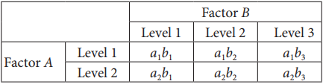
Types of Experimental Designs(cont.)
Crossing:
Expressing the design in terms of factors, called the factorial design
How many diﬀerent treatment combinations are required.
Two factors, A and B, in a design are crossed if each level of each factor appears with each level of the other factor. This relationship is denoted as A × B

Slide 29
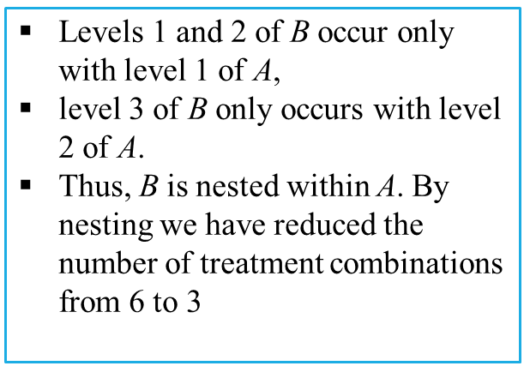
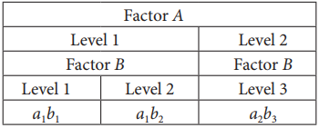
Types of Experimental Designs(cont.)
Nesting:
Factor B is nested within factor A if each meaningful level of B occurs in conjunction with only one level of factor A.
The relationship is depicted as B(A), where B is the nested factor and A is the nest factor.

Slide 30
Empirical Research Guidelines

Slide 31
Contents
Experimental context
Experimental design
Data collection
Analysis
Presentation of results
Interpretation of results

Slide 32

1. Experimental Context
Goals:
Ensure that the objectives of the experiment have been properly defined
Ensure that the description of the experiment provides enough details for the practitioners

Slide 33
1. Experimental Context
C1: Be sure to specify as much of the context as possible. In particular, clearly define the entities, attributes and measures that are capturing the contextual information.
C2: If a specific hypothesis is being tested, state it clearly prior to performing the study, and discuss the theory from which it is derived, so that its implications are apparent.
C3: If the target is exploratory, state clearly and, prior to data analysis, what questions the investigation is intended to address, and how it will address them.

Slide 34

2. Experimental Design
Goal:
Ensure that the design is appropriate for the objectives of the experiment
Ensure that the objective of the experiment can be reached using the techniques specified in the design

Slide 35
2. Experimental Design /1
D1: Identify the population from which the subjects and objects are drawn.
D2: Define the process by which the subjects and objects were selected (inclusion/exclusion criteria).
D3: Define the process by which subjects and objects are assigned to treatments.
D4: Restrict yourself to simple study designs or, at least, to designs that are fully analyzed in the literature.
D5: Define the experimental unit.

Slide 36

3. Data Collection
Goal
Ensure that the data collection process is well defined
Monitor the data collection and watch for deviations from the experiment design

Slide 37
3. Data Collection
DC1: Define all software measures fully, including the entity, attribute, unit and counting rules.
DC2: Describe any quality control method used to ensure completeness and accuracy of data collection.
DC3: For observational studies and experiments, record data about subjects who drop out from the studies.
DC4: For observational studies and experiments, record data about other performance measures that may be adversely affected by the treatment, even if they are not the main focus of the study.

Slide 38
4. Analysis
Goal
Ensure that the collected data from the experiment is analyzed correctly
Monitor the data analysis and watch for deviations from the experiment design

Slide 39
4. Analysis
A1: Specify any procedures used to control for multiple testing.
A2: Consider using blind analysis (avoid “fishing for results”).
A3: Perform sensitivity analysis.
A4: Ensure that the data do not violate the assumptions of the tests used on them.
A5: Apply appropriate quality control procedures to verify the results.

Slide 40
5. Presentation of Results
Goal
Ensure that the reader of the results can understand the objective, the process and the results of experiment

Slide 41
5. Presentation of Results
P1: Describe or cite a reference for all procedures used. Report or cite the statistical package used.
P2: Present quantitative results as well as significance levels. Quantitative results should show the magnitude of effects and the confidence limits.
P3: Present the raw data whenever possible. Otherwise, confirm that they are available for review by the reviewers and independent auditors.
P4: Provide appropriate descriptive statistics.
P5: Make appropriate use of graphics.

Slide 42
6. Interpretation of Results
Goal
Ensure that the conclusions are derived merely from the results of the experiment

Slide 43
6. Interpretation of Results
I1: Define the population to which inferential statistics and predictive models apply.
I2: Differentiate between statistical significance and practical importance.
I3: Specify any limitations of the study.

